Slide 1

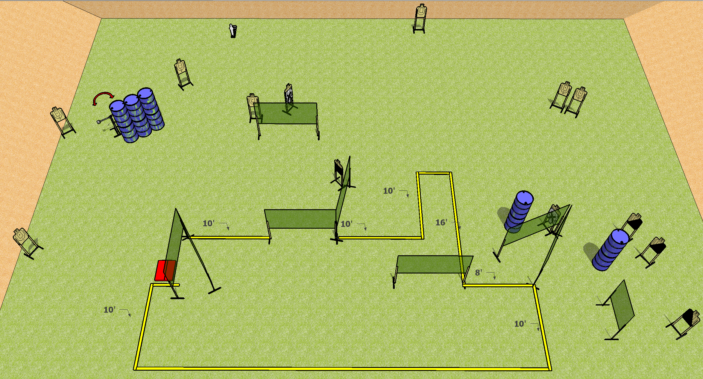
 | Dothan Practical Shooters – USPSA Match What Is My Purpose? Course Designer : Drew Coleman Bay: A3
Round Count 29 rounds 14 USPSA 1 mini popper
Equipment List 17 wall feet Stomp box + swinger

Slide 2
What Is My Purpose?
Written Stage Briefing
Scoring: Comstock Rounds: 29
Targets: 14 USPSA, 1 Steel
Handgun start position: anywhere inside the shooting area, wrists below belt. Handgun is loaded and holstered.
PCC start position: anywhere inside the shooting area, stock on belt. Loaded carbine is held with both hands, safety on.
Stage Procedure: on the audible start signal, engage targets as they become available from within the shooting area. The swinger is activated by the stomp pad and remains visible at rest.

